Slide 1

My SQL Capstone Project:
SportStats

Slide 2

Table of Contents:
Review of Questions to Answer/Hypotheses/Approach
Discuss Technical Challenges
Detail: Entity Relationship Diagram (ERD)
Initial Findings
Deeper Analysis
Hypotheses Results

Slide 3

1. Questions to Answer
Q1: Is there any correlation between the performance of a country in winter Olympics and that in summer Olympics?
Q2: Does country performance by year change more in Winter Olympics or Summer Olympics?
Q3: How has the male:female ratio evolved through time?
. Questions to Answer

Slide 4

Section 2 Initial Hypotheses
H1: Yes.
H2: Winter Olympics.
H3: Decreased.

Slide 5

Section 3: Data Analysis Approach
A1: Calculate the Pearon correlation coefficient.
A2: Calculate the standard deviation in country performance through years. A Comparison between average std of Winter and that of Summer Olympics will help.
A3: Draw a simple histogram.

Slide 6
Technical Challenges
Encountered challenges with getting the starting year of the Summer Olympics different from that of the Winter Olympics
Limitation of Pandasql (Sqlite) made some SQL difficult to execute but manageable

Slide 7
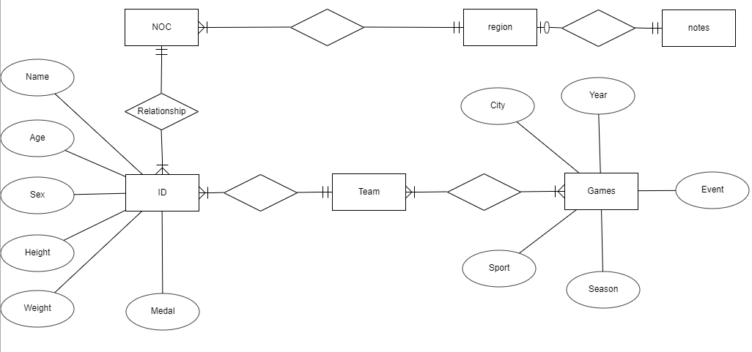
Entity Relationship Diagram (ERD)

Slide 8
Initial Findings
Although the ratio between the Summer Olympics and the Winter Olympics is indeed different, men happen to be dominant. My first assumption is that the ratio of women to men has increased over time. I began to dive into it.
There are significant differences between male and female participants not only in terms of expected height and weight, but also in terms of age. The first two differences can be attributed to biology. Although the latter may require more than just: it is worth considering social factors at the same time.
Another interesting fact is that the age gap in the Winter Olympics is much smaller (~2.8 years old and 1.5 years old)
Another analysis of the number and ratio of medals is needed. I checked the ratio of total medal winners and the changes in the ratio of different medals:

Slide 9
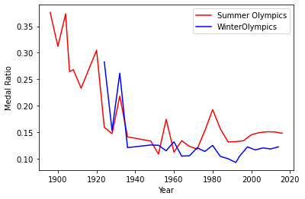

Initial Findings II
In the last century, the medal ratio fluctuated greatly in the two competitions, but eventually stabilized. This can be interpreted as establishing norms on these issues.

Slide 10
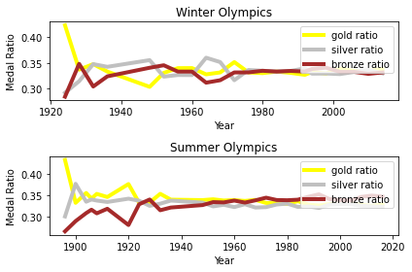

Initial Findings III
The relative percentages of gold, silver and bronze medals have also stabilized, which may be due to the reasons mentioned above.

Slide 11
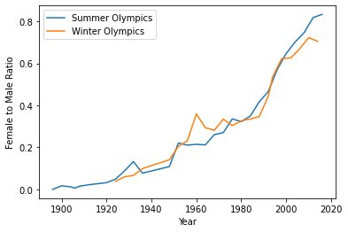
Initial Findings IV
This assumption seems to be correct. Over time, the ratio of women to men has indeed increased. However, there is an interesting detail: during the Second World War, the proportion of the Summer Olympics dropped sharply, but then it resumed its growth momentum. Without further analysis, I cannot explain this phenomenon.

Slide 12
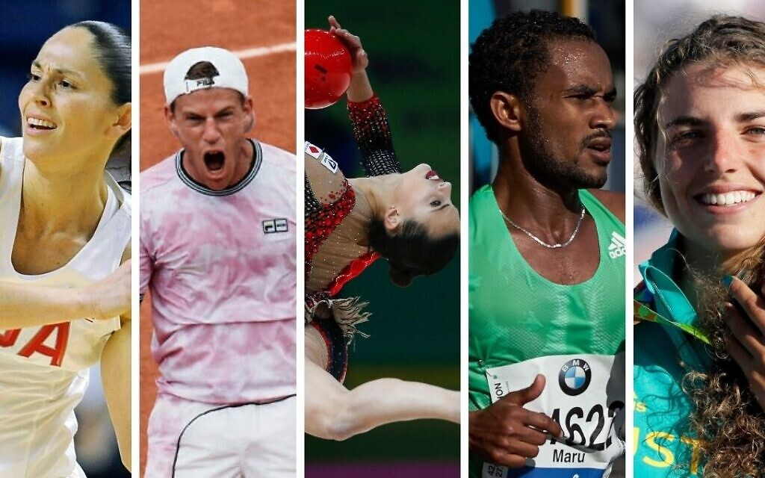
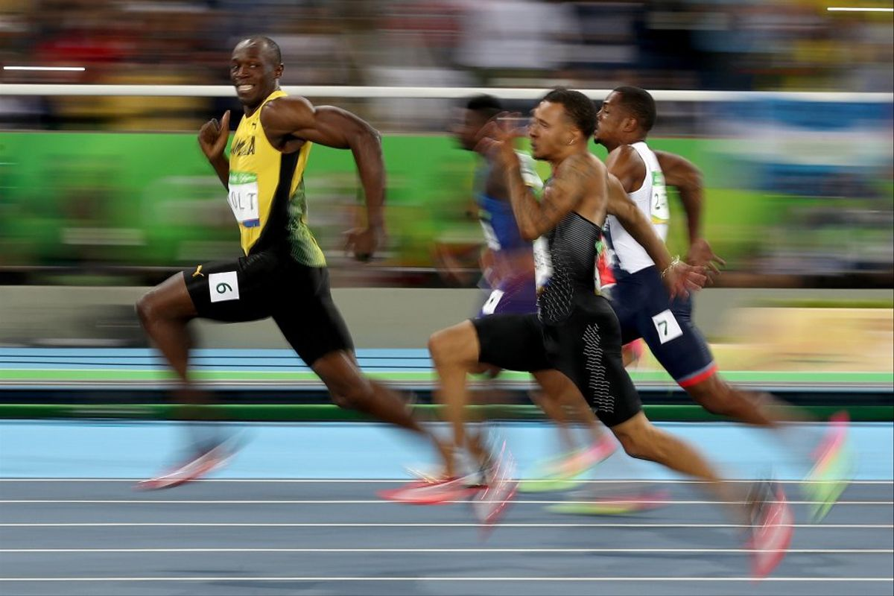
Deeper Analysis
The length of the array of the number of medal count in the winter Olympics and summer Olympics are different because Winter Olympics started in 1924, but Summer Olympics started in 1896. Therefore I have to create a new shortened table of the summer Olympics started in 1924 to match the length of the winter Olympics.

Slide 13
Deeper Analysis II
The Pearon correlation coefficient between the total number of medals in the winter and summer olympics from 1924 to 2016, is 0.94, which is highly positive. Therefore, the performance of a country in winter olympics is highly correlated to that in summer olympics
I will then calculate the standard deviation in country performance through years. A Comparison between average std of Winter and that of Summer Olympics will help.
Deeper Analysis (part

Slide 14
Deeper Analysis III
std_medal_count_summer_olympics = 475
std_medal_count_winter_olympics = 153
From 1924 to 2016, as the standard deviation in the summer olympics is about 3 times that in the winter olympics, country performance by year change more in Summer Olympics.

Slide 15
Final Findings (Result of Hypotheses)
Yes, the performance of a country in winter Olympics is highly correlated to that in summer Olympics
Yes, the country performance by year change more in Winter Olympics than that in Summer Olympics.
The male:female ratio has decreased from 1896 t o 2016

Slide 16
Recommendations
The Olympiad Organizing Committee should devote more resource in the weather prediction to help organize the Olympics, as the weather affects the performance of athletes
The Olympiad Organizing Committee should advocate the equality between male and female and keep encouraging more female to join the Olympics

Slide 17


